Slide 1

Course: Electronic Engineering UEC001
Topic: Complement and Logic Gates
Presentation by
Ajay Kakkar
ajay.kakkar@thapar.edu
9781506922
Assistant Professor
Department of Electronics and Communication Engineering,

Slide 2
Logic Gates
Logic gates are abstractions of electronic circuit components that operate on one or more input signals to produce an output signal.
2-Input AND
2-Input OR
NOT (Inverter)
A
A
F
G
A
H
B
B
H = A’
F = A•B
G = A+B
Reference Book: M. M. Mano and M.D. Ciletti, Digital Design, Pearson, Prentice Hall, 2013.

Slide 3
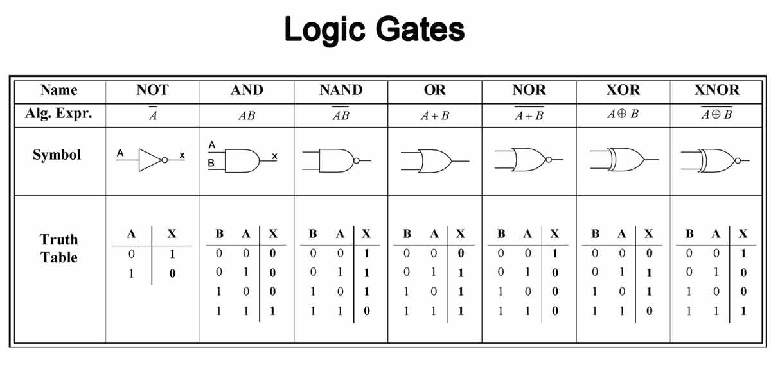
Reference Book: M. M. Mano and M.D. Ciletti, Digital Design, Pearson, Prentice Hall, 2013.

Slide 4
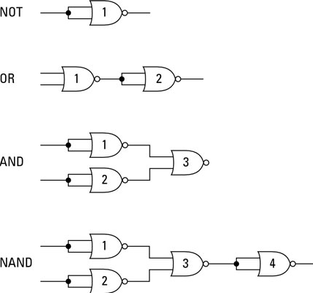
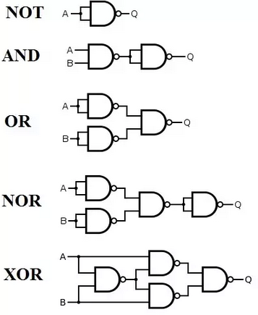
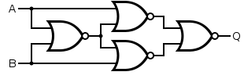
Universal Gates
XNOR
Reference Book: M. M. Mano and M.D. Ciletti, Digital Design, Pearson, Prentice Hall, 2013.

Slide 5
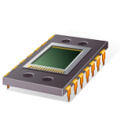
Universal Gate – NAND
This presentation will demonstrate
The basic function of the NAND gate.
How a NAND gate can be used to replace an AND gate, an OR gate, or an INVERTER gate.
How a logic circuit implemented with AOI logic gates can be re-implemented using only NAND gates.
That using a single gate type, in this case NAND, will reduce the number of integrated circuits (IC) required to implement a logic circuit.
AOI Logic
NAND Logic
More ICs = More $$
Less ICs = Less $$
Reference Book: M. M. Mano and M.D. Ciletti, Digital Design, Pearson, Prentice Hall, 2013.
Notes:
Introductory Slide / Overview of Presentation

Slide 6

NAND Gate
X
Y
X | Y | Z
0 | 0 | 1
0 | 1 | 1
1 | 0 | 1
1 | 1 | 0
Reference Book: M. M. Mano and M.D. Ciletti, Digital Design, Pearson, Prentice Hall, 2013.
Notes:
Overview of basic NAND gate : Logic Symbol, Logic Expression (using DeMorgan’s) and Truth Table.

Slide 7

NAND Gate as an Inverter Gate
(Before Bubble)
X
X | Z
0 | 1
1 | 0
Equivalent to Inverter
Reference Book: M. M. Mano and M.D. Ciletti, Digital Design, Pearson, Prentice Hall, 2013.
Notes:
When you tie the inputs on a NAND gate together, the output will be the complement of the input.

Slide 8

NAND Gate as an AND Gate
X
Y
NAND Gate
Inverter
X | Y | Z
0 | 0 | 0
0 | 1 | 0
1 | 0 | 0
1 | 1 | 1
Equivalent to AND Gate
Reference Book: M. M. Mano and M.D. Ciletti, Digital Design, Pearson, Prentice Hall, 2013.
Notes:
This one is easy to see, a NAND gate is an AND gate with the output inverted. So if you invert the output again, you will get an AND gate. Note that we are using a NAND gate for the inverter.

Slide 9
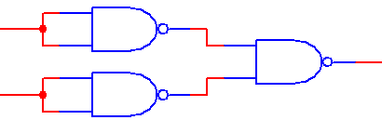
NAND Gate as an OR Gate
X
Y
Inverters
NAND Gate
X | Y | Z
0 | 0 | 0
0 | 1 | 1
1 | 0 | 1
1 | 1 | 1
Equivalent to OR Gate
Reference Book: M. M. Mano and M.D. Ciletti, Digital Design, Pearson, Prentice Hall, 2013.
Notes:
This one is a bit harder to see. If you invert both of the inputs of a NAND gate, you will get an OR gate. Note that we’re using NAND gates as inverters.

Slide 10



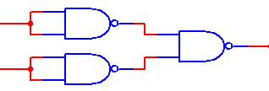


NAND Gate Equivalent to AOI Gates
AND
OR
INVERTER
Reference Book: M. M. Mano and M.D. Ciletti, Digital Design, Pearson, Prentice Hall, 2013.
Notes:
Summary of the three AOI gates and their NAND equivalent.

Slide 11
Process for NAND Implementation
If starting from a logic expression, implement the design with AOI logic.
In the AOI (And Or Inverter) implementation, identify and replace every AND,OR, and INVERTER gate with its NAND equivalent.
Redraw the circuit.
Identify and eliminate any double inversions (i.e., back-to-back inverters).
Redraw the final circuit.
Reference Book: M. M. Mano and M.D. Ciletti, Digital Design, Pearson, Prentice Hall, 2013.
Notes:
Process for implementing NAND only circuits from AOI.

Slide 12
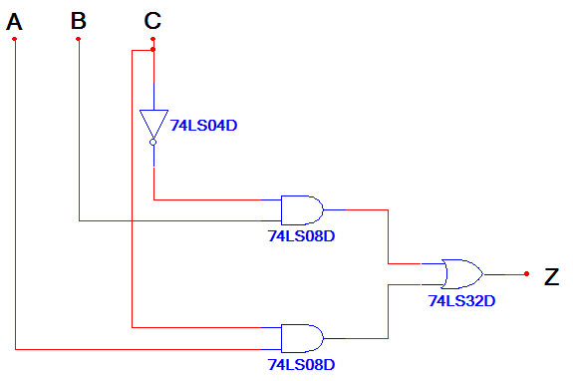
NAND Implementation
Example:
Design a NAND Logic Circuit that is equivalent to the AOI circuit shown below.
Reference Book: M. M. Mano and M.D. Ciletti, Digital Design, Pearson, Prentice Hall, 2013.
Notes:
Example

Slide 13
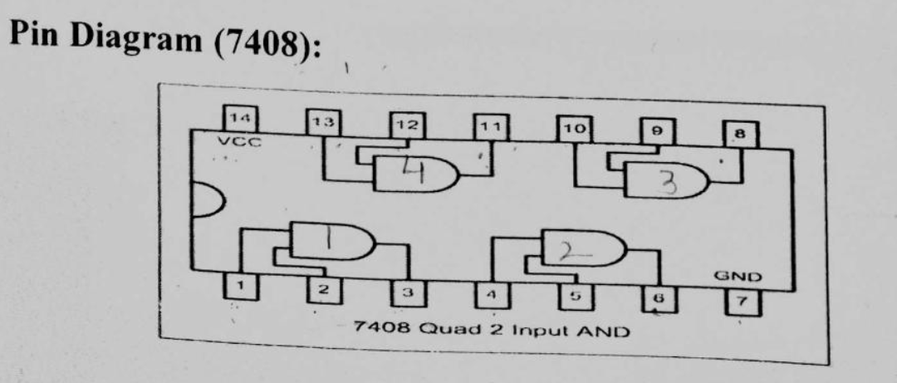
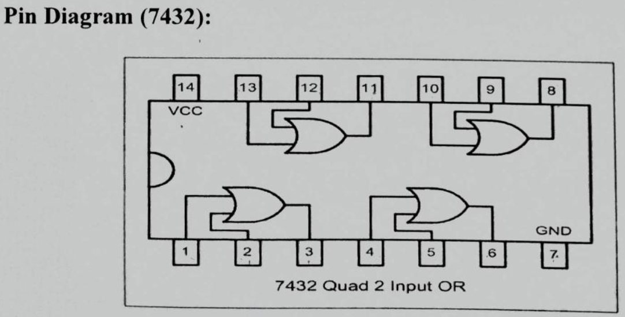
Reference Book: M. M. Mano and M.D. Ciletti, Digital Design, Pearson, Prentice Hall, 2013.

Slide 14
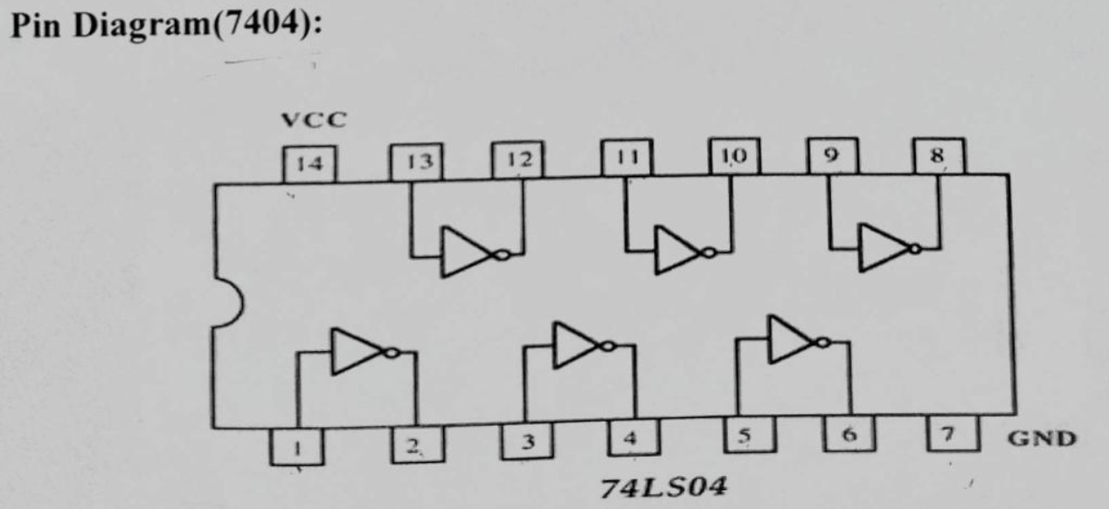
Reference Book: M. M. Mano and M.D. Ciletti, Digital Design, Pearson, Prentice Hall, 2013.

Slide 15
NAND Implementation
Solution – Step 2
Identify and replace every AND,OR, and INVERTER gate with its NAND equivalent.
Reference Book: M. M. Mano and M.D. Ciletti, Digital Design, Pearson, Prentice Hall, 2013.
Notes:
Example : Solution Step 2 (Note that there wasn’t a step 1 because we started with an AOI circuit.)

Slide 16
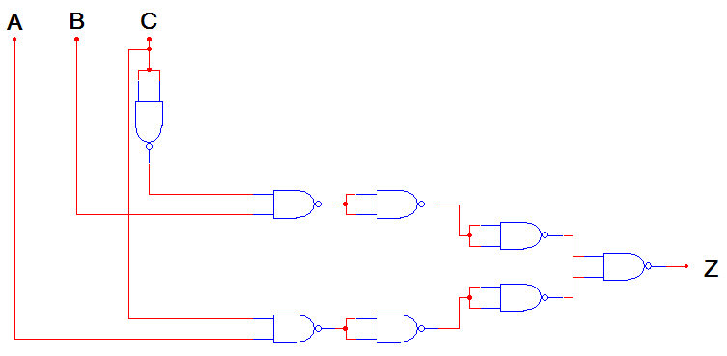
NAND Implementation
Solution – Step 3
Redraw the circuit.
Reference Book: M. M. Mano and M.D. Ciletti, Digital Design, Pearson, Prentice Hall, 2013.
Notes:
Example : Solution Step 3

Slide 17
NAND Implementation
Solution – Step 4
Identify and eliminate any double inversions.
Reference Book: M. M. Mano and M.D. Ciletti, Digital Design, Pearson, Prentice Hall, 2013.
Notes:
Example : Solution Step 4

Slide 18
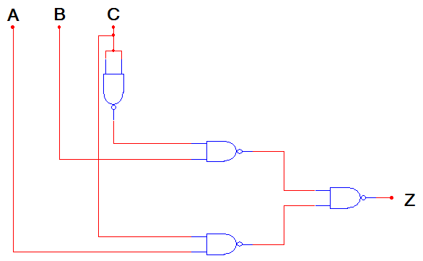
NAND Implementation
Solution – Step 5
Redraw the circuit.
Reference Book: M. M. Mano and M.D. Ciletti, Digital Design, Pearson, Prentice Hall, 2013.
Notes:
Example : Solution Step 5

Slide 19
Proof of Equivalence
Reference Book: M. M. Mano and M.D. Ciletti, Digital Design, Pearson, Prentice Hall, 2013.
Notes:
Algebraic proof that the NAND only circuit is equivalent to the AOI.

Slide 20
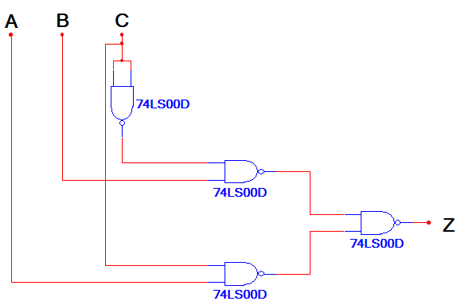
AOI vs. NAND
IC Type | Gates | Gate / IC | # ICs
74LS04 | 1 | 6 | 1
74LS08 | 2 | 4 | 1
74LS32 | 1 | 4 | 1
Total Number of ICs → |  |  | 3
IC Type | Gates | Gate / IC | # ICs
74LS00 | 4 | 4 | 1
Total Number of ICs → |  |  | 1
Reference Book: M. M. Mano and M.D. Ciletti, Digital Design, Pearson, Prentice Hall, 2013.
Notes:
Comparison of the two implementations. Note the reduced IC count (3 to 1), which would result in a cost savings.

Slide 21
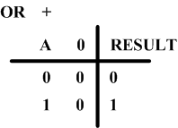
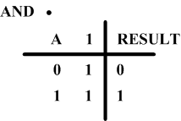
Basic Identities of Boolean Algebra
X + 0 = X
X + 1 = 1
X + X = X
X · 1 = X
X · 0 = 0
X · X = X
Reference Book: M. M. Mano and M.D. Ciletti, Digital Design, Pearson, Prentice Hall, 2013.

Slide 22
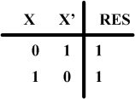
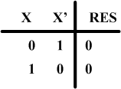
Basic Identities (2)
X + X’ = 1
(X’)’ = X
X · X’ = 0
Reference Book: M. M. Mano and M.D. Ciletti, Digital Design, Pearson, Prentice Hall, 2013.

Slide 23
Basic Properties (Laws)
Commutative
X + Y = Y + X
Associative
X+(Y+Z)=(X+Y)+Z
Distributive
X(Y+Z) =XY+XZ
AND distributes over OR
Commutative
X · Y = Y · X
Associative
X(YZ) = (XY)Z
Distributive
X+YZ=(X+Y)(X+Z)
OR distributes over AND
Reference Book: M. M. Mano and M.D. Ciletti, Digital Design, Pearson, Prentice Hall, 2013.

Slide 24
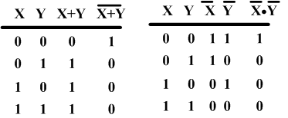
Basic Properties (2)
DeMorgan’s Theorem
Very important in simplifying equations
(X + Y)’ = X’ · Y’
(XY)’ = X’ + Y’
Reference Book: M. M. Mano and M.D. Ciletti, Digital Design, Pearson, Prentice Hall, 2013.

Slide 25
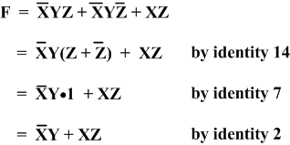
Simplify, simplify
These properties (Laws and Theorems) can be used to simplify equations to their simplest form.
Simplify F=X’YZ+X’YZ’+XZ
Reference Book: M. M. Mano and M.D. Ciletti, Digital Design, Pearson, Prentice Hall, 2013.

Slide 26
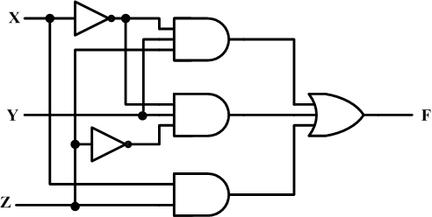
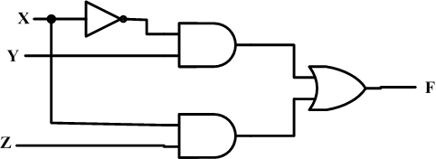
Affect on implementation
F = X’YZ + X’YZ’ + XZ
Reduces to F = X’Y + XZ
Reference Book: M. M. Mano and M.D. Ciletti, Digital Design, Pearson, Prentice Hall, 2013.

Slide 27
Other examples
Examples from the text
1. X + XY = X·1 + XY = X(1+Y) = X·1 = X
Use 2 14 3 2
2. XY+XY’ = X(Y + Y’) = X·1 = X
Use 14 7 2
3. X+X’Y = (X+X’)(X+Y) = 1· (X+Y) = X+Y
Use 15 7 2
Reference Book: M. M. Mano and M.D. Ciletti, Digital Design, Pearson, Prentice Hall, 2013.

Slide 28
Further Examples
Examples from the text
4. X· (X+Y)=X·X+X·Y= X+XY=X(1+Y)=X·1=X
Use 14 6 14 3 2
5. (X+Y) ·(X+Y’)=XX+XY’+XY+YY’=
X+XY’+XY+0=X(1+Y’+Y)=X·1=X
by a slightly different reduction
6. X(X’+Y) = XX’+XY = 0 + XY = XY
Reference Book: M. M. Mano and M.D. Ciletti, Digital Design, Pearson, Prentice Hall, 2013.

Slide 29
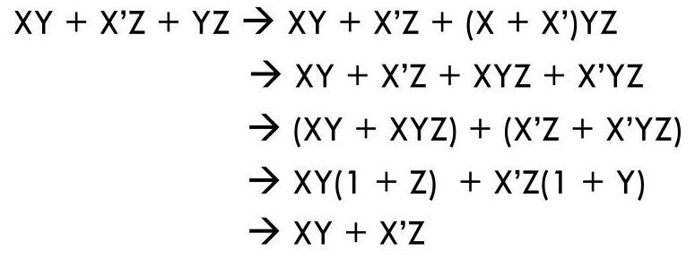
Consensus Theorem
The Theorem gives us the relationship
XY + X’Z + YZ = XY + X’Z
Reference Book: M. M. Mano and M.D. Ciletti, Digital Design, Pearson, Prentice Hall, 2013.

Slide 30
Application of Consensus Theorem
Consider
(A+B)(A’+C) = AA’ + AC + A’B + BC
= AC + A’B + BC
= AC + A’B

